Slide 1
ACCESS TO FINANCE
Partner: CDI and IHF

Slide 2
Objectives & Goals
At the end of this module you will be able to:
Understand the basics and principles of entrepreneurship
Acquire abilities to discover opportunities for self-employment
Gain knowledge of the main alternative means to credit and how to choose among them
Search for and exploit alternative funding opportunities related to crowdfunding, business angels, venture capitalists or grants

Slide 3
Index
Unit 1 - Financial Literacy
Section 1: Role and structure of entrepreneurship
Section 1.1: Selection of a business idea
Section 2: Money and transactions
Section2.1: Planning and managing finances
Section 2.2: Equity Finance vs Debt Finance
Section 3: Risk and reward
Section3.1: Financial safety net
Extra Tools
EU database to search for funding opportunities:
Your Europe Business – The “Access to Finance” tool
Unit 2 - Alternative means to credit
Section 1: Crowdfunding
Section 1.1: How to start a crowdfunding campaign
Section 2: Business Angels & Venture Capitalists
Section 2.1: EU Support network
Section 3: Grants
Section 3.1: EU grants, two examples

Slide 4
1. Financial literacy – Role and structure of entrepreneurship
Entrepreneurship is the capacity and willingness to create, plan, and manage a business operation, including all of its uncertainties, with the goal of turning a profit. Starting new enterprises is the most well-known example of entrepreneurship.
4 Types of Entrepreneurship:
Small Business Entrepreneurship
Scalable Startup Entrepreneurship
Large Company Entrepreneurship
Social Entrepreneurship

Slide 5
1. Financial literacy – Selection of a business idea
Define goals
Determine objectives to reach goals
Assess resources and make decisions
Create contingency plans for managing changes
Rationally assess operational feasibility and financial viability

Slide 6
1. Financial literacy – Money and transactions
According to the Transaction definition, it is a finalized agreement between a seller and a buyer for transferring goods, services, or financial assets in exchange for money is known as a transaction.
Cash Transaction
&
Credit Transaction
Internal Transaction
&
External Transaction
1
2

Slide 7
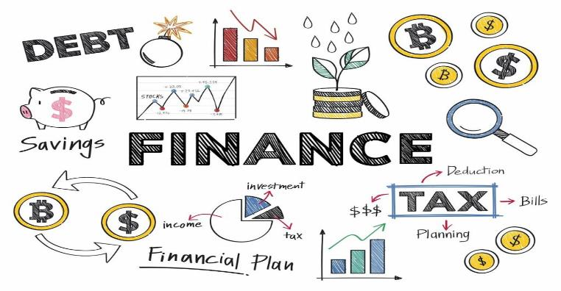
1. Financial literacy – Planning and managing finances
Financial Planning is the process of:
Estimating the capital required and determining it’s competition
Framing financial policies in relation to procurement, investment and administration of funds of an enterprise.

Slide 8
1. Financial literacy – Planning and managing finances
THE BUDGET
The specifics of your budget will depend on your personal financial situation and goals.
In most cases, the steps for creating a budget are the same. You can make a budget by following seven simple steps.
https://www.investopedia.com/terms/b/budget.asp

Slide 9
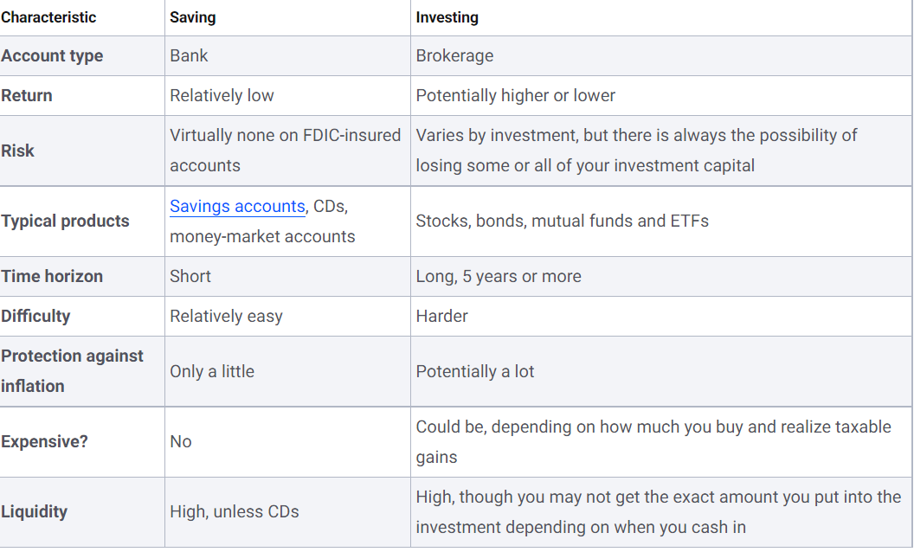
1. Financial literacy – Planning and managing finances
The table below summarizes some of the key differences between saving and investing
https://www.bankrate.com/investing/saving-vs-investing/

Slide 10
1. Financial literacy – Debt Finance vs Equity Finance
A company funds its operations through two different sources.
DEBT FINANCING | EQUITY FINANCING
Conventional loan through a traditional lender (i.e., a bank) Cost of financing: interest rate (fixed cost) Capital can be obtained at a lower effective costs and quickly | Capital in exchange for equity (% of ownership in the business) No debt payment required Cost of financing: % of future earnings
Debt financing is suggested when:
1. A positive return is expected
2. There is the possibility to deal with the risk
(in case of collateral and failure in the repayment of the debt)
Equity financing is suggested when:
1. Willing to avoid debt that can hurt the company cash flow
2. The business is not yet profitable or it is a start-up

Slide 11
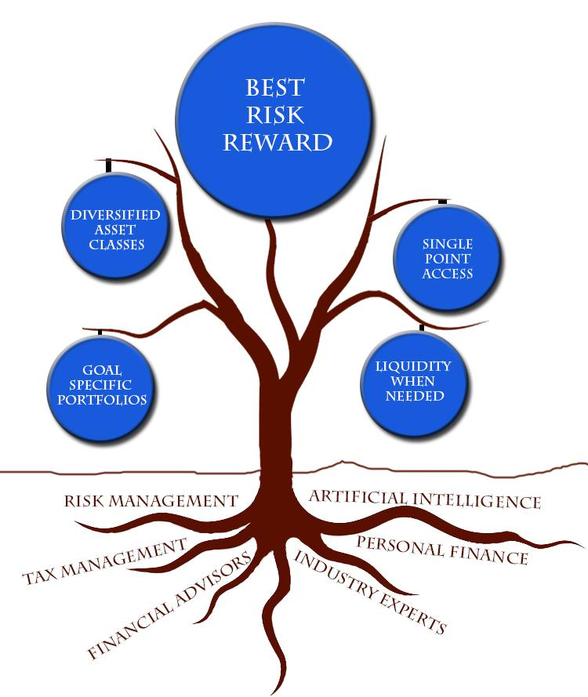
1. Financial literacy – Risks and Rewards
The risk/reward ratio, sometimes known as the R/R ratio, is a measure that compares the potential profit of a trade to its potential loss.
Interest-rate risk is the potential that a change in overall interest rates will reduce the value of a bond or other fixed-rate investment
Inflation risk is the risk that your purchasing power will be reduced if the value of your investments does not keep up with inflation
Credit risk is the possibility of a loss resulting from a borrower's failure to repay a loan or meet contractual obligations
https://www.investopedia.com/terms/r/riskrewardratio.asp

Slide 12
1. Financial literacy – Financial Safety Module
A financial safety plan is a combination of various insurance policies and a savings account.
Its function is to help you reduce financial risks that may be caused by unexpected expenses. It protects you and your family's long-term financial goals by giving you a fallback plan that will not derail your overall financial plan.
Financial Stability
‍A financial safety net gives you financial stability by providing a cushion for any financial emergency. With a financial plan, all your income and expenditures are structured to meet your financial goal. Any slight change in the routine could put your finances off balance.
It Helps You Organize Your Financial Plan
A safety net plan is part of your financial plan. Having it included in your financial plan gives it structure and organization. A safety net can be classified as one of the strategies for meeting your mid-term and long-term financial goals.

Slide 13
2. Alternative means to credit – Crowdfunding
Among the most popular alternative means to credit, there is crowdfunding, which includes internet-based initiatives aimed at funding a project/business idea by raising small amounts of money from a large number of people.
This financing mechanism is characterized by lower intermediation costs and lesser emphasis on risk assessment.
Other features:
Reward based investments (investors receive a final product rather than repayment)
Suitable for product-based businesses rather than service-based activities
Good communication and marketing skills required
Little barrier to entry Gaining costumers while crowdfunding No repayment requirements | Crowdfunding platforms fees High effort to organize an successful campaign Suitability for only some businesses

Slide 14
2. Alternative means to credit – How to start a crowdfunding campaign
To choose the right platform for a crowdfunding campaign, the following factors should be consider:
Which is the platform’s crowdfunding model?
Reward-based (the most suitable for small businesses), equity-based, donation-based
2. What happens if the target is not reached?
All-or-nothing campaigns are often more successful that keep-it all campaigns
3. Which are the target audiences of the platform?
Generalised Platform vs Specialised Platform
A specialised platform for women
IFundWomen is widely recognized as the crowdfunding industry leader for female founders and creators. It also offers to its members an online course on how to crowdfund.
Source: IFundWomen website
4. How much will it cost?
Search for the exact fees of the platform, also considering the taxes on the money raised.

Slide 15
2. Alternative means to credit – Business Angels & Venture Capitalists
BUSINESS ANGELS
Private investors (typically managers or entrepreneurs) investing their own money in innovative ideas with high profitability potentials, in exchange for equity.
They tend to invest lower amounts earlier in the fundraising process
Within the business, they will provide for mentorship and networking opportunities.
To start financing a business idea, Business Angels can offer a great support.
However, there are some challenging factors, like how to find them (see next slide) or how to approach them (see the following tips):
Make sure to know your potential Angel’s background and experience
Communicate the importance of your product (a good Business Plan is the key)
Keep it simple - “Would a child understand your business proposition?”
VENTURE CAPITALISTS
Venture capitalists are institutional investors; they invest large amounts in businesses later in the fundraising process and in exchange for more equity.
They tend to ignore small businesses and can lead to a loss of company control.

Slide 16
2. Alternative means to credit – EU Support network
It is possible to reach for Business Angels by consulting one of the many specialised platforms
or by attending networking events in order to meet face-to-face the potential investors.
The European Commission offers plenty of networking initiatives for women entrepreneurs, which can support them also in finding the right Business Angel:
WA4E
The Women Business Angels for Europe's Entrepreneurs (WA4E) is the Business Angels Europe programme unlocking female angel investment and access to risk capital for women entrepreneurs.
Crunchbase
Angel List
Seed Invest
Funders Club
WEgate Platform
The European Gateway for Women’s entrepreneurship WEgate is an e-platform launched by the European Commission, a growing network of stakeholders that are engaging to support women entrepreneurs across Europe. WEgate provides information and links on access to training, mentoring, advice and business networking opportunities at EU level as well as national level.
See also…
The women entrepreneurship group of the EEN
The group connects women entrepreneurs to the Enterprise Europe Network and provides concrete services, (business partnering, access to foreign markets, cooperation with local networks and access to EU funding)
Top 40 business angels in EU
Female Business Angels

Slide 17
2. Alternative means to credit – Grants
Get a grant and obtain debt-free money sounds like the most preferable option.
However, there are some factors to keep in mind:
Eligibility requirements
Stiff competition
Long and detailed application processes that may be time-consuming; moreover, the planning and writing of a proposal may require the external support of a consultant/expert and therefore additional costs.
Grants are often addressed to groups that face obstacles in getting traditional loans, as in the case of women - in particular if coming from disadvantaged areas (e.g., rural areas).
Where to search for this opportunity?
The WEgate Platform (introduced in the previous slide) represents a practical tool also to monitor specific grants opportunities for women at national level. Information can be filtered by country and keywords at the following links:
“Financing and funding” section https://wegate.eu/start/financing-funding
“Starting a business” section https://wegate.eu/start/starting-business

Slide 18
2. Alternative means to credit – EU Grants, two examples
Women TechEU
A new initiative of the European Union funded by the Horizon Europe Programme.
Among its several services, it offers financial support to female company as an individual grant of EUR 75,000 to support the initial steps in the innovation process, and the growth of the company.
Click on the image for more info
REQUIREMENTS FOR APPLICATIONS
Be a woman
Be a founder or co-founder of an early stage deep tech start-up
Hold a top management position (CEO, CTO or equivalent) in the company

Slide 19
2. Alternative means to credit – EU Grants, two examples
2. EIC Accelerator
The initiative, that is part of the European Innovation Council pilot, supports high-risk, high-potential small and medium-sized enterprises and innovators to help them develop and bring onto the market new innovative products, services and business models. Startups and SMEs with female CEOs are particularly welcomed.
The EIC Accelerator provides blended finance composed of:
An investment component
(direct equity or quasi-equity such as convertible loans)
A grant component to reimburse eligible costs incurred for innovation activities (e.g. demonstration of the technology, prototyping, R&D and testing required to meet regulatory requirements, intellectual property management, marketing approval. etc
Click on the image for more info

Slide 20
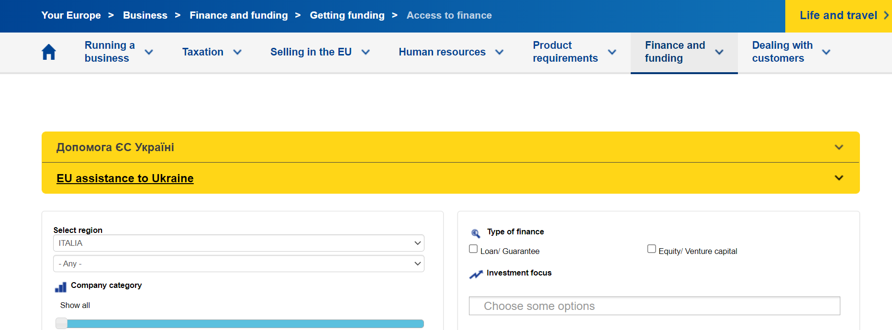
EU database to search for funding opportunities
Your Europe Business - The “Access to Finance” tool
Access to EU Finance - European Commission (europa.eu)

Slide 21
Summing up
Entrepreneurship is the ability and readiness to develop, organize and run a business enterprise, along with any of its uncertainties in order to make a profit.
Equity financing involves selling a portion of a company's equity in return for capital.
ebt financing involves the borrowing of money and paying it back with interest.
A business plan is a document that defines in detail a company's objectives and how it plans to achieve its goals.
There are several alternative means to credit. To chose the right one it is necessary to assess its own skills and initial resources.

Slide 22
Thank you!
Partner: CDI & IHF

